Slide 1
EEE 333 Hardware Design Languages and Programmable Logic
Topics:
Lab 2:
Full Adder/Subtractor” Task
Overflow detection
ALU

Slide 2
Adders Behavior

Slide 3
Under what conditions do we detect an overflow?
Overflow in Unsigned Binary (UB) addition
When adding two k-bit bitstrings using UB, you are adding two non-negative numbers. Assuming you are adding two positive numbers, overflows will occur since the result is larger than the largest positive integer. For n bits, the maximum value is 2^{n} - 1.
When a sum is larger than 2^{n} - 1, it takes n + 1 bits to represent the result. So, you can tell overflow just by checking if the carry out of the leftmost adder (which adds the most significant bits and the carry in) is 1. OVF = Cout.

Slide 4
Under what conditions do we detect an overflow?
Overflow in Signed Binary (SB) addition
If x and y have opposite signs (one is negative, the other is non-negative), then the sum will never overflow. Just try it out. The result will either be x or y or somewhere in between.
Thus, overflow can only occur when x and y have the same sign.
One way to detect overflow is to check the sign bit of the sum. If the sign bit of the sum does not match the sign bit of x and y, then there's overflow. This only makes sense.

Slide 5
Under what conditions do we detect an overflow?
Overflow in Signed Binary (SB) addition
Suppose x and y both have sign bits with value 1. That means, both representations represent negative numbers. If the sum has sign bit 0, then the result of adding two negative numbers has resulted in a non-negative result, which is clearly wrong. Overflow has occurred.
Suppose x and y both have sign bits with value 0. That means, both representations represent non-negative numbers. If the sum has sign bit 1, then the result of adding two non-negative numbers has resulted in a negative result, which is clearly wrong. Overflow has occurred.
So that would suggest that one way to detect overflow is to look at the sign bits of the two most significant bits and compare it to the sum.

Slide 6
Misconceptions about Overflow
Overflow occurs when you do some operation to two valid representations, and the result can not be represented in the representation because the value is too large or too small.
Overflow detection is detecting overflow for a specific representation. Too often people mistake overflow detection for overflow. Thus, students say "overflow is when the carry out is a 1". Specific detection of overflow requires knowing the operation and the representation.
Thus, "overflow is when the carry out is a 1" is only correct when the representation is unsigned numbers and the operation is addition. In this case, I claim that OVF = Cout.
Overflow detection for signed binary addition is different. One way to detect it is to XOR the carry-in and the carry-out of the most significant bits.

Slide 7
Summary of Detecting Overflow
Overflow (result too large for finite computer word)
No overflow when adding a positive and a negative number
Overflow occurs when the value affects the sign:
overflow when adding two positives yields a negative or, adding two negatives gives a positive
or, subtract a negative from a positive and get a negative
or, subtract a positive from a negative and get a positive

Slide 8
C₄
C₃
C₂
C₁
C₀=0
Adders
A₃ A₂ A₁ A₀
+ B₃ B₂ B₁ B₀
C_{OUT} S₃ S₂ S₁ S₀
Overflows can occur
ONLY when numbers have the same sign.
Six 2-bit addition scenarios.
C₃=
1
0
1
0
1
0
LSB
MSB
1 X 1 X 0 X 0 X 1 X 1 X
1 X 1 X 0 X 0 X 0 X 0 X
1 1 X
1 0 X
0 1 X
0 0 X
1 0 X
0 1 X
NV
NV
C_{OUT}
NV
C_{OUT}
OF
C_{OUT}
OF
C_{OUT}
NV
C_{OUT}
C_{OUT}

Slide 9
Adders
Overflows occur only when the carry into and carry out of the most significant bit differ.
{
OVF =
1 if overflow occurs
0 if no overflow occurs

Slide 10
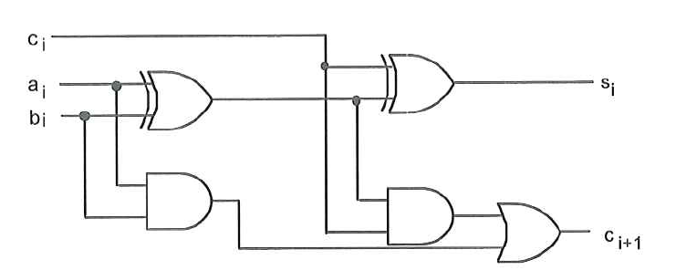
One-bit Adder
Using K-Maps and Boolean Algebra simplifications:
S_{i} = c_{i} ^ (a_{i} ^ b_{i})
C_{i+1} = a_{i} & b_{i} | c_{i} & b_{i} | c_{i} & a_{i}

Slide 11
Adders
Four-Bit Adder with OF detect for SIGNED NUMBERS.
A₃
B₃
A₂
B₂
A₁
B₁
A₀
B₀
A B
A B
A B
A B
F.A.
F.A.
F.A.
F.A.
C_{IN}=0?
C_{OUT}
C_{IN}
C_{OUT}
C_{IN}
C_{OUT}
C_{IN}
C_{OUT}
C_{IN}
SUM
SUM
SUM
SUM
S₃
S₂
S₁
S₀
OF

Slide 12
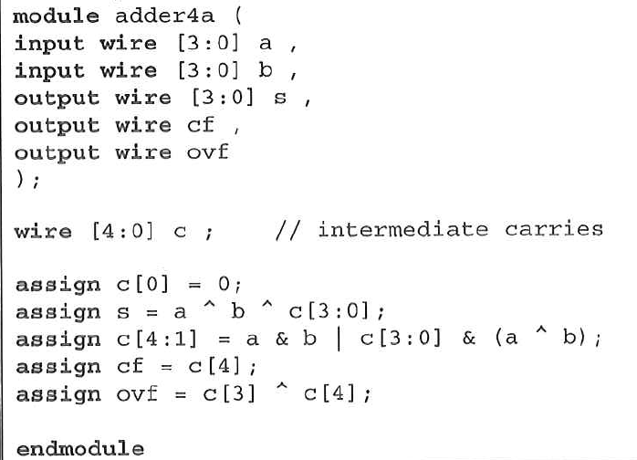
4-Bit Adder: Logic Equations
Note that the carry bits are defined as internal wires.
The output carry flag, cf, is equal to c4.
The output overflow flag, ovf, is defined as the exclusive-or of c3 and c4.
The overflow flag is set when a and b are considered to be signed numbers between -8 and +7 and the correct answer is outside of this signed range.

Slide 13
4-Bit Adder: Logic Equations
The sums is always equal to a+ b. Note that the carry flag, cf is equal to 1 when the correct unsigned answer exceeds 15 (or F). Also note that the overflow flag, ovf, is 1 when the correct signed answer is outside the range -8 to +7.
For example, when a is 8 this is equivalent to the signed value -8, which when added to b (which is equivalent to -5) gives a sum of s = -8-5 = -13. Which is outside the range of -8 to +7. However, when hex D (-3) is added to hex B (-5) the answer is -8, which is 1000, or 8, so the sum is correct and the overflow flag is 0.

Slide 14
4-Bit Adder: Behavior statements
It would be convenient to be able to make a 4-bit adder (or any size adder) by just using a + sign in a Verilog statement. In fact, we can! When you write a + b in a Verilog program the compiler will produce a full adder of the type we designed in previous example. The only question is how to create the output carry bit. The trick is to add a leading 0 to a and b and then make a 5-bit temporary variable to hold the sum as shown in next slide. The most-significant bit of this 5-bit sum will be the carry flag.

Slide 15
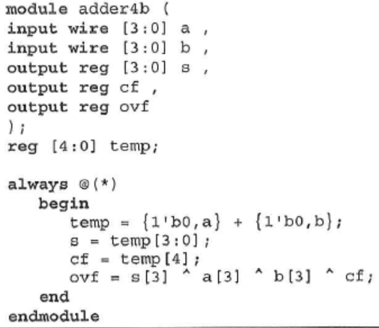
4-Bit Adder: Behavior statements

Slide 16
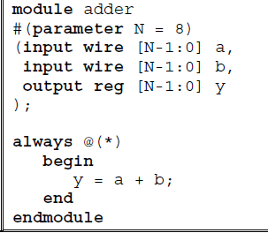
N-Bit Adder: Behavior statements
N-bit adder that uses a parameter statement. This is a convenient adder to use when you don’t need the carry flag. An example of using this as an 8-bit adder is shown below. Note that when the sum exceeds FF it simply wraps around and the carry flag is lost.

Slide 17
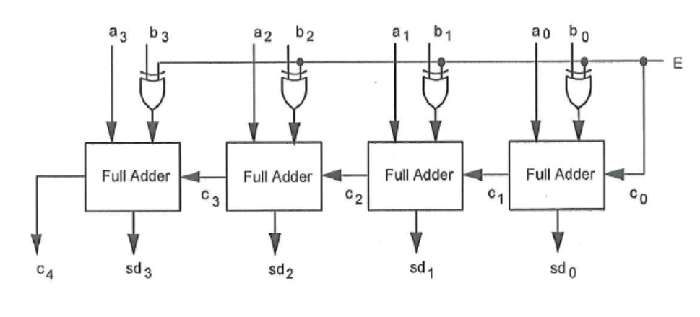
Four bit 2’s Complement adder/subtracter
Note that the value of the outputs is a + b if E = 0, and is a - b or a + (2’s complement of b) if E = 1.
bx(3) bx(2) bx(1) bx(0)

Slide 18
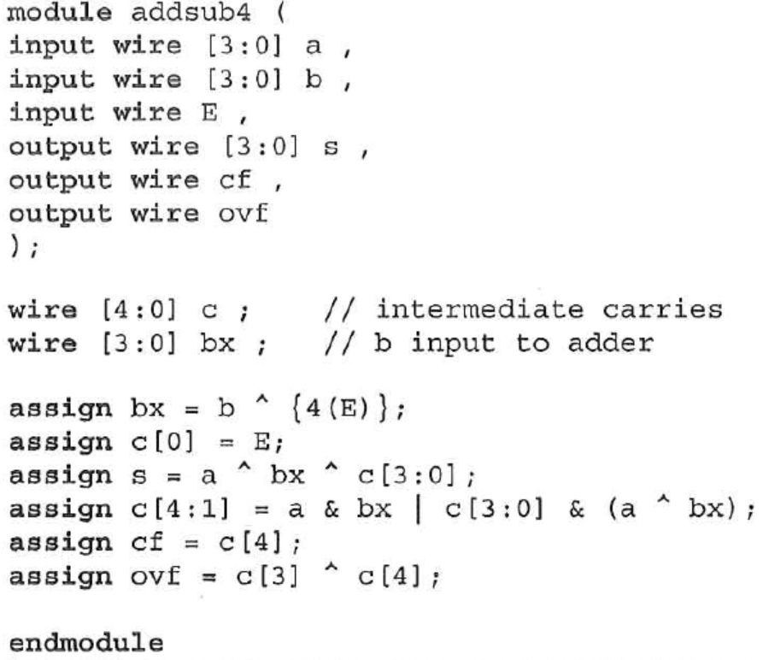
Four bit 2’s Complement adder/subtractor

Slide 19
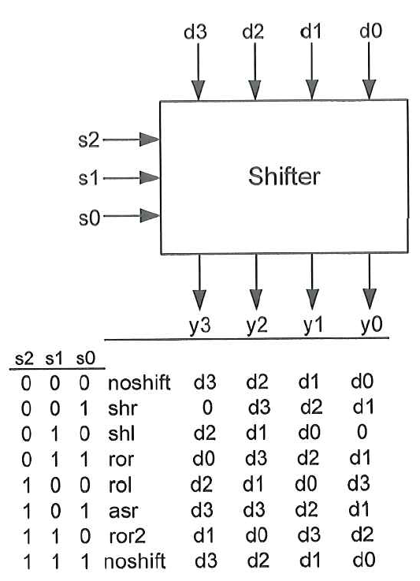
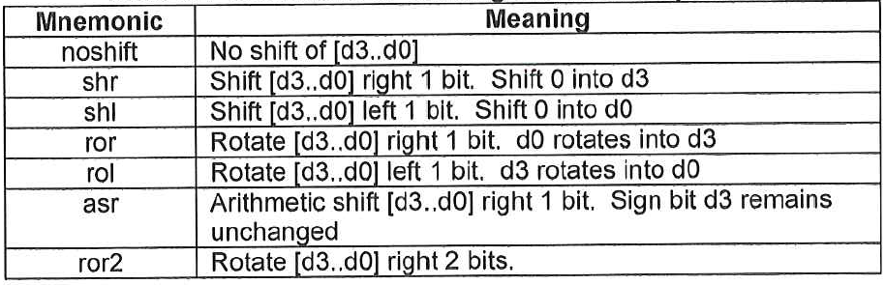
Shifters
A 4-bit shifter module is shown. Note that the 4-bit ouput [y3 ..y0] represents some form of the 4-bit input [d3 ..d0] shifted, or rotated, left or right. The eight possible operations and their meaning are shown in the truth table are controlled by the three control inputs [s2 ..s0].
Definitions and Shifting and Rotate Operations
Note that shifting a binary number 1 bit to the left is equivalent to multiplying by 2 and shifting a binary number 1 bit to the right is equivalent to dividing by 2.

Slide 20
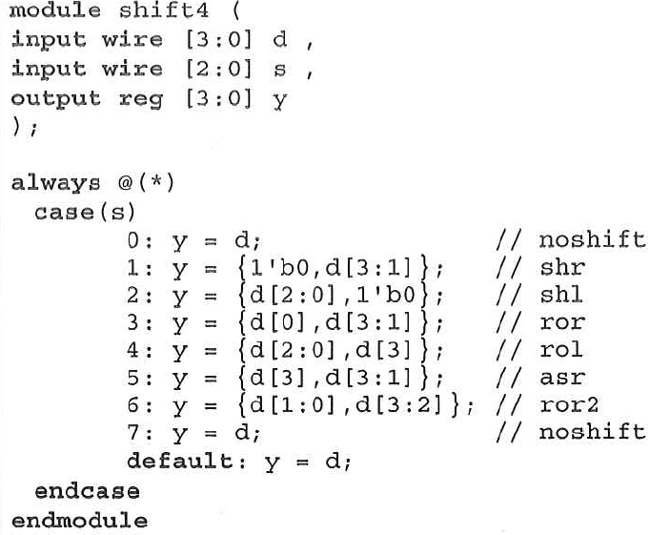
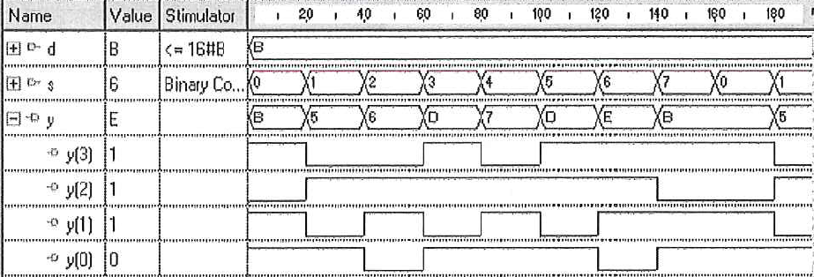
Example of 4-bit Shifters
we can use a case statement as shown to implement a shifter.

Slide 21
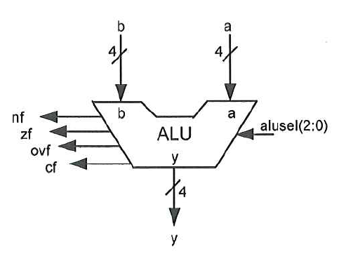
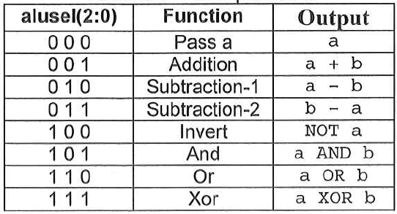
Example of 4-bit ALU
In addition to the 4-bit output y(3:0), four flags are also output from the ALU.
The carry flag, cf, and the overflow flag, ovf, are the carry/borrow and overflow flags from the addition and subtraction operations.
The zero flag, zf, is 1 if the output y is "0000".
The negative flag, nf, is 1 if the sign bity(3) is 1.

Slide 22
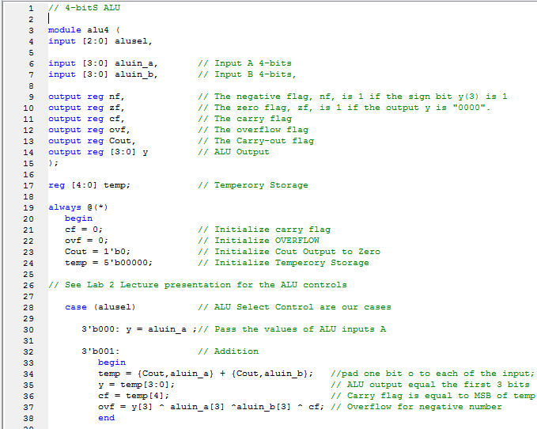
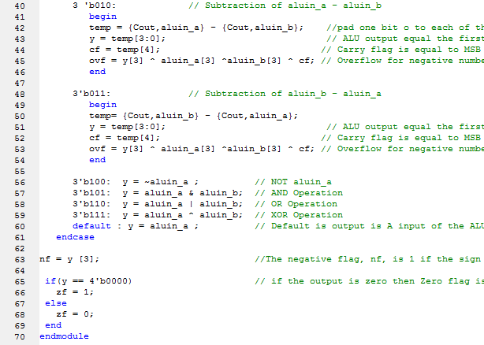
ALU Code

Slide 23
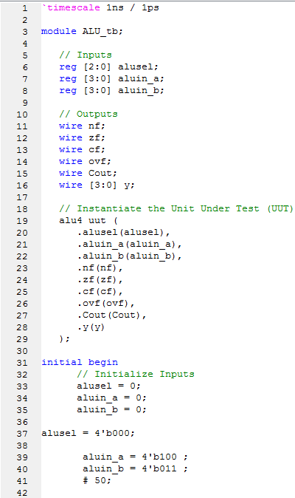
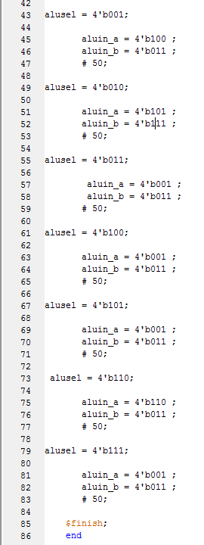
ALU Test bench

Slide 24
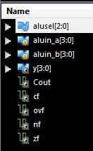
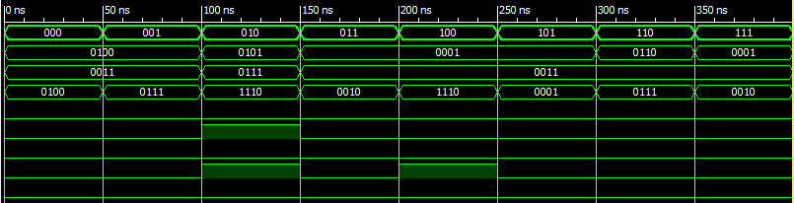
ALU Test bench Results
3
3
1
1
3
3
3
3

Slide 25
The End

